Slide 1

Working in IT
.

Slide 2
Why we work – SPEAKING and VOCABULARY 1. Complete the phrases below with the correct prepositions.
• drag ourselves …… of bed every morning
• nobody in this room thinks that that's the answer …… the question
• a pretty bad reason …… doing the work that we do
• the overwhelming majority …… people
• the role that ideas play …… shaping us
• deprives people …… the opportunity
• we take …… granted
OUT
TO
FOR
OF
IN
OF
FOR

Slide 3
2. Match the underlined words and phrases to their meanings.
What do you do to make a living?
How does your employer incentivize you to work hard?
What rewards do you get in your job?
a) something given in exchange for good behaviour or good work:
b) to earn enough money to buy the things you need:
c) to make someone want to do something:
REWARD
MAKE A LIVING
INCENTIVIZE

Slide 4
3. What does it mean for you when work is :
challenging?
engaging?
stimulating?
meaningful?

Slide 5
4. Look at the list of work aspects and choose 5 which motivate you most. Explain your choice.
peer motivation
desire to do a good job
feeling encouraged and recognized
having a real impact
growing professionally
meeting client/customer needs
money and benefits
good manager
believing in the company
other

Slide 6
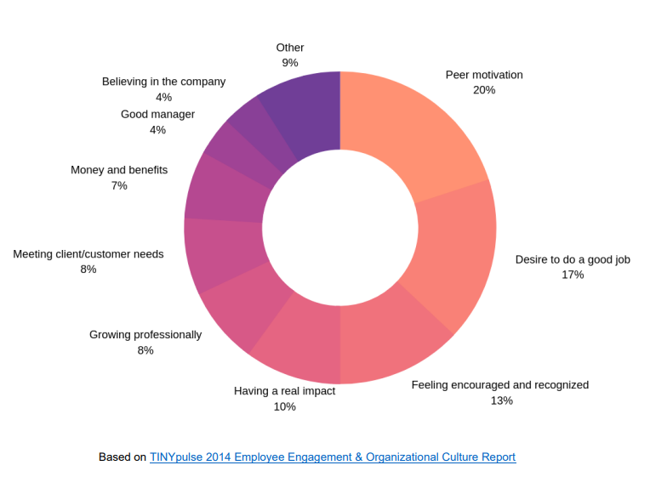
5. Compare your answers with the research findings.

Slide 7
6. Complete the definitions with the words in the box.
cushy dead-end full-time part-time permanent
temporary worthwhile zero-hours
a) In a ………………….. job you work all day, five days a week.
b) In a ………………….. job you work a limited number of hours or days.
c) A ………………….. job lasts for a limited period of time.
d) A ………………….. job lasts until you decide to leave.
e) A job with a ………………….. contract has no established regular hours.
f) In a ………………….. job you never get promoted.
g) In a ………………….. job you get paid for doing easy and pleasant things.
h) In a ………………….. job the work you do is important or has value.
FULL-TIME
PART-TIME
TEMPORARY
PERMANENT
ZERO-HOURS
DEAD-END
CUSHY
WHORTHWHILE

Slide 8
7. Cross out one word that doesn’t collocate with the word career in each line. Discuss the meaning of the others.
a) brief, promising, successful, great, sophisticated CAREER
b) build, create, pursue, have, resume CAREER
c) CAREER break, advice, path, route, structure
d) peak of, change of, span of, embark on, set off CAREER
e) CAREER chances, opportunities, ladder, expansion, advancement

Slide 9
8. Discuss these questions in pairs (use the vocabulary from ex. 7).
a) Should people know where they want to be in their career in 5-10 years’ time?
b) Do you have a clear vision and ultimate goal for your career?
c) What can you do to advance your career?
d) What’s the best and the worst time to have a change of career?
e) Is a career break a good idea? Why/why not?

Slide 10
9. What is a great career for you? Rank the following aspects in order of their importance for a great career. Compare it with your partner.
doing something you are passionate about
having a big paycheck
being in a position of power
making a positive difference
having a work-life balance
having an intellectually stimulating and challenging job
being able to constantly develop yourself
being respected and well-known

Slide 11
10. Discuss, in pairs, which of the following aspects influence career choices and try to select the 3 most significant ones.
• location
• education
• luck
• social background
• timing
• skills and abilities
• previous experiences
• gender
• contacts

Slide 12
GRAMMAR 1. Match the grammar structures (box) with examples of how they are used to give advice (a-e).
a) If I were in your position, I would go for a career in IT.
b) Why don’t you consider moving to a different country to get a job?
c) You’d better think what your strengths and weakness are before making any career choices.
d) Try asking people around before deciding what you want to do.
e) You should look for a job that you would be passionate about.
modal verbs had better 2nd conditional
question imperative
2nd conditional
question
had better
imperative
modal verbs

Slide 13
2. Use the phrases from above to give some advice/ suggestions for the situations below.
• What's a career that doesn't require too much effort, no degrees and still won't leave you mentally, physically or financially miserable?
• Should I make a safe career choice or take a risk and pursue my passion?
• My husband told me I should make my dream (modelling) a hobby, instead of trying to make it a career.
• Is it alright if I choose game design as a future career if I'm not into videogames?
• I’m thinking about dropping out of college to develop myself as a composer and transform this hobby into my career.
• What should I do if my wife wants to make a career change I don't agree with right now?

Slide 14
3. Look at the pieces of career advice below and decide in pairs which four you consider most important nowadays.
• Make time to network and build stronger relationships with those you work with.
• Be proactive - people want solutions not problems and a 'can do' positive and flexible attitude.
• Play to your strengths - how can you utilise what you are great at to address the challenges of your employer or clients?
• Don't cruise or be complacent - look at your blind spots to come through difficult times stronger.
• Don’t forget about self-promotion.
• Be creative - think outside the box.
• Invest in your own development; reading, researching and skill-swaps are cost effective alternatives to expensive training courses.
• Give more than expected - go that extra mile and add more value.

